Slide 1



Investing for network reliability – the Greek case
Evangelia Gazi
Member of the Board
GREECE - Regulatory Authority for Energy, Waste & Water (RAAEY)
Session 2b, 22/09/2026

Slide 2
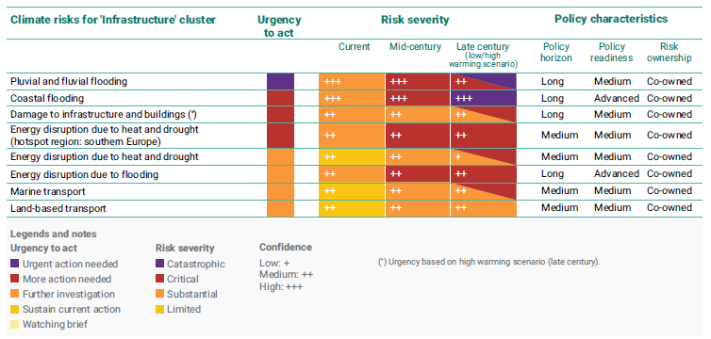
European Climate Risk Assessment
In January 2024, the European Commission published its first comprehensive assessment to identify the European climate adaptation-related policy priorities in climate-sensitive sectors. It identifies 36 climate risks with potentially severe consequences across Europe.
https://www.eea.europa.eu/en/analysis/publications/european-climate-risk-assessment

Slide 3
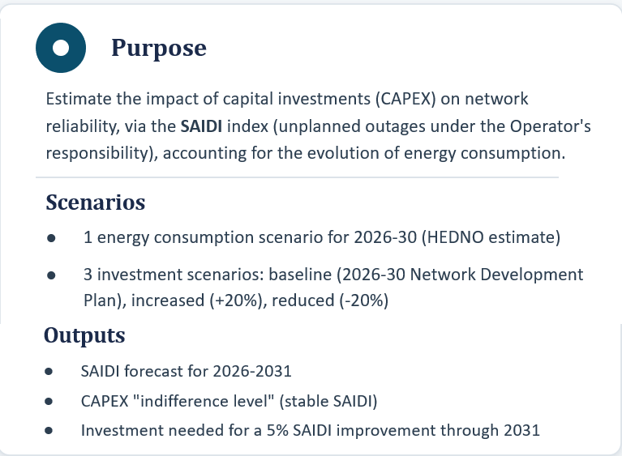
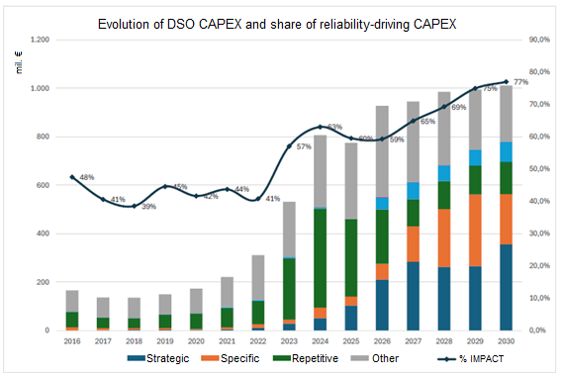
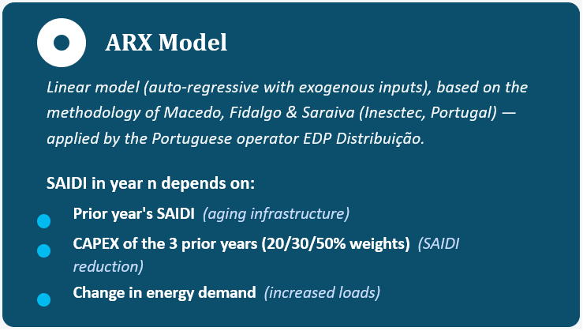
Impact of DSO’s CAPEX Plan on Network Reliability - I
*
* https://repositorio.inesctec.pt/server/api/core/bitstreams/28a53a99-7391-41a5-8b3b-6c2ca3b9c004/content

Slide 4
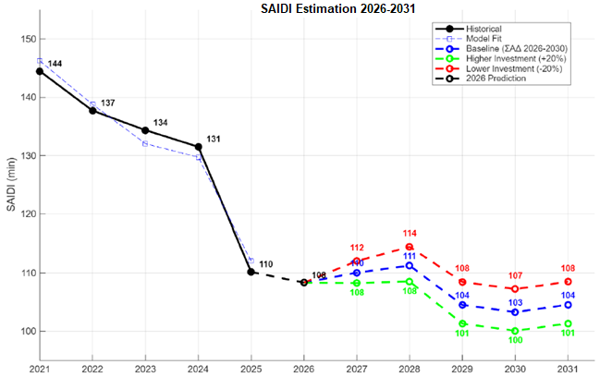
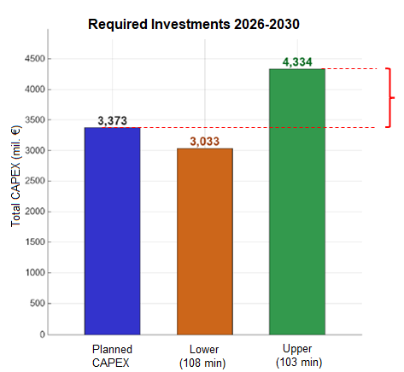
Impact of DSO’s CAPEX Plan on Network Reliability - II

Slide 5
Prioritization of investment
Split network to areas according to:
Investment type:
Customer impact
?
Bare overhead wire
SAIDI / SAIFI
Vegetation-related faults
Aerial bundled cables
Fault rate
CAPEX
Wildfire-related exposure
Intervention time
Underground cables
Maintenance cost

Slide 6
Investing for network reliability – the Greek case
Session 2b - Network reliability in a world of increasing climate change

